Slide 1


Boosting Algorithm
Dharani Palaniappan

Slide 2
Types of Boosting
Ada Boosting
XG Boosting
Gradient Boosting

Slide 3
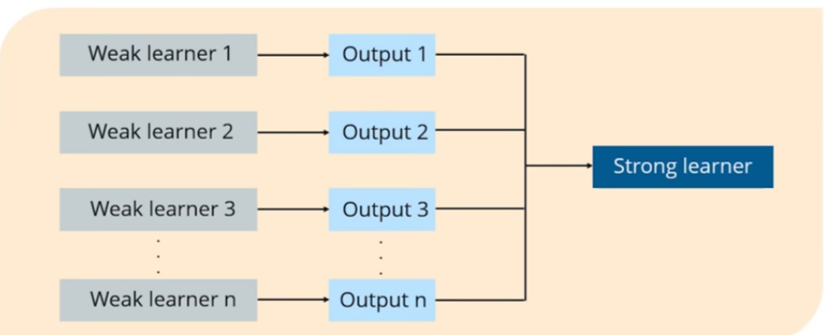
Boosting
Boosting is a process that uses a set of Machine Learning algorithms to combine weak learner to form strong learners in order to increase the accuracy of the model.

Slide 4
AdaBoost
Ada boost is the first boosting algorithm among all the boosting algorithms. The main idea behind this algorithm is to combine multiple weak learners to into a strong classifier. It can be used for both classification and regression tasks.
One way for a new predictor to correct its predecessor is to pay a bit more attention to the training instances that the predecessor has incorrectly classified. This results in new predictors focusing more and more on the hard cases. This is the technique used by Ada‐Boost.
For example, to build an Ada Boost classifier, a first base classifier (such as a Decision Tree) is trained and used to make predictions on the training set. The relative weight of misclassified training instances is then increased. A second classifier is trained using the updated weights and again it makes predictions on the training set, weights are updated, and so on
When the random forest is used, the algorithm makes n number of trees. It makes proper trees that consist of a start node with several leaves nodes. Some trees might be bigger than others, but there is no fixed depth in a random forest. But with Adaboost, that’s not the case. In AdaBoost, the algorithm only makes a node with two leaves, and this is known as Stump.

Slide 5
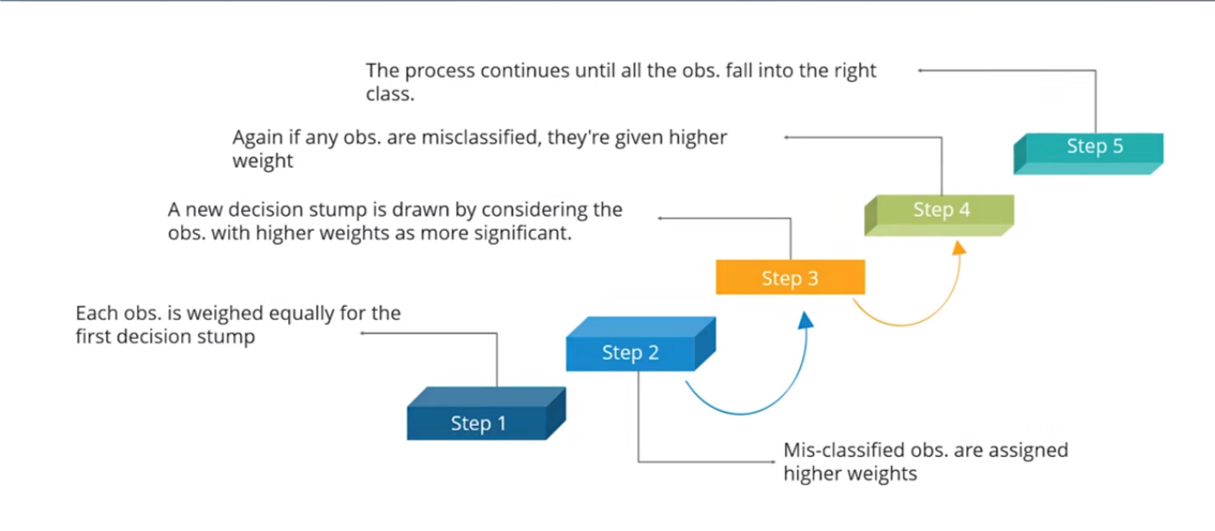
How it Works

Slide 6
Python Code
from sklearn.ensemble import AdaBoostRegressor
from sklearn.tree import DecisionTreeRegressor
model = AdaBoostRegressor(
base_estimator=DecisionTreeRegressor(max_depth=3),
n_estimators=100,
learning_rate=0.5
)
model.fit(X_train, y_train)
predictions = model.predict(X_test)

Slide 7
Practical Applications
Ada Boost can be used to solve a variety of real-world problems, such as predicting customer churn and classifying the types of topics customers are talking/calling about.
The algorithm is heavily utilised for solving classification problems, given its relative ease of implementation in languages such as R and Python.
Detection Pedestrian Using Patterns of Motion and Appearance
Research Paper published by Paul Viola, Michael J. Jones, Daniel Snow on IEEE ICCV(International Conference on Computer Vision)
A pedestrian detection system using image intensity information and motion information with the detectors trained by AdaBoost.

Slide 8
Ada Boosting
Advantages
Disadvantages
Ada Boost has a lot of advantages, mainly it is easier to use with less need for tweaking parameters unlike algorithms like SVM.
Theoretically, Ada Boost is not prone to overfitting though there is no concrete proof for this. It could be because of the reason that parameters are not jointly optimized — stage-wise estimation slows down the learning process.
Ada Boost can be used to improve the accuracy of your weak classifiers hence making it flexible.
It has now being extended beyond binary classification and has found use cases in text and image classification as well.
Boosting technique learns progressively, it is important to ensure that you have quality data.
Ada Boost is also extremely sensitive to Noisy data and outliers so if you do plan to use Ada Boost then it is highly recommended to eliminate them.
Ada Boost has also been proven to be slower than XG Boost.

Slide 9
Gradient Boosting
Another very popular Boosting algorithm is Gradient Boosting. Just like Ada Boost, Gradient Boosting works by sequentially adding predictors to an ensemble, each one correcting its predecessor. However, instead of tweaking the instance weights at every iteration like Ada Boost does, this method tries to fit the new predictor to the residual errors made by the previous predictor.
The base learners are generated sequentially in such a way that the present base learner is always more effective than the previous one.
It can be used for both classification and regression problems.

Slide 10
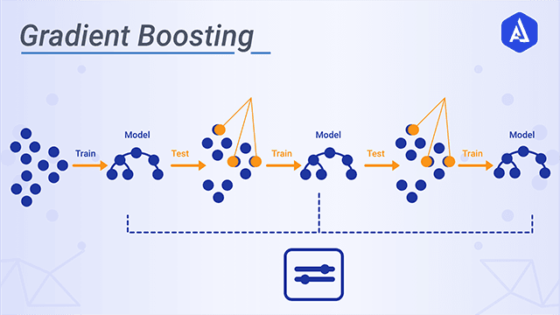
How it Works

Slide 11
Python Code
from sklearn.ensemble import GradientBoostingClassifier
gbc = GradientBoostingClassifier(n_estimators=300,
learning_rate=0.05,
random_state=100,
max_features=5 )
gbc.fit(train_X, train_y)
pred_y = gbc.predict(test_X)
acc = accuracy_score(test_y, pred_y)
print("Gradient Boosting Classifier accuracy is : {:.2f}".format(acc))

Slide 12
Advantages
Disadvantages
Often provides predictive accuracy that cannot be trumped.
Lots of flexibility – can optimize on different loss functions and provides several hyper parameter tuning options that make the function fit very flexible.
No data pre-processing required – often works great with categorical and numerical values as is.
Handles missing data – imputation not required.
A benefit of the gradient boosting framework is that a new boosting algorithm does not have to be derived for each loss function that may want to be used, instead, it is a generic enough framework that any differentiable loss function can be used
Gradient Boosting Models will continue improving to minimize all errors. This can overemphasize outliers and cause overfitting.
Computationally expensive – often require many trees (>1000) which can be time and memory exhaustive.
The high flexibility results in many parameters that interact and influence heavily the behavior of the approach (number of iterations, tree depth, regularization parameters, etc.). This requires a large grid search during tuning.
Less interpretative in nature, although this is easily addressed with various tools.

Slide 13
Practical Applications
Neurobotics – Gradient boosting is a useful practical tool for predictive tasks, and consistently provides higher accuracy results compared to conventional single strong machine learning models.
For example, gradient boosting helps to create models that can map the EMG and EEG sensor readings to human movement tracking and activity recognition.
Gradient boosting can be used in the field of learning to rank. The commercial web search engines Yahoo and Yandex use variants of gradient boosting in their machine-learned ranking engines.
Gradient boosting is also utilized in High Energy Physics in data analysis. At the Large Hadron Collider (LHC), variants of gradient boosting Deep Neural Networks (DNN) were successful in reproducing the results of non-machine learning methods of analysis on datasets used to discover the Higgs boson

Slide 14
XG Boosting
Gradient boosting is an ensemble method that sequentially adds our trained predictors and assigns them a weight. However, instead of assigning different weights to the classifiers after every iteration, this method fits the new model to new residuals of the previous prediction and then minimizes the loss when adding the latest prediction. So, in the end, you are updating your model using gradient descent and hence the name, gradient boosting. This is supported for both regression and classification problems. XGBoost specifically, implements this algorithm for decision tree boosting with an additional custom regularization term in the objective function.
In recent years the main driving force behind the algorithms that won massive ML competitions is Xtreme Gradient Boost or Xgboost.

Slide 15
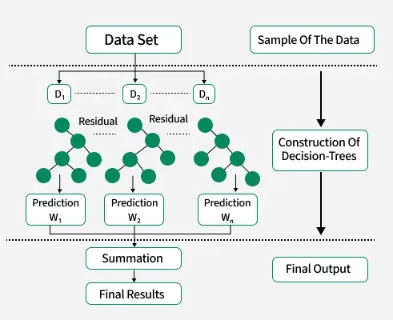
How it works

Slide 16
Key Features
Key Features of XGBoost for Regression
Boosting Framework: XGBoost builds an ensemble of decision trees sequentially, where each tree corrects the errors of the previous one.
Objective Function: For regression, it minimizes a loss function (e.g., Mean Squared Error or Mean Absolute Error) while adding regularization to prevent overfitting.
Regularization: Includes L1 (Lasso) and L2 (Ridge) regularization to improve generalization.
Handling Missing Values: Automatically handles missing data by learning the best direction to split.
Parallelization: Optimized for speed with parallel processing.
Customizability: Allows users to define custom loss functions.

Slide 17
Python Code
from xgboost import XGBRegressor
# Train XGBoost model
model = XGBRegressor(n_estimators=100, learning_rate=0.1, max_depth=3, random_state=42)
model.fit(X_train, y_train)
# Predict and evaluate
preds = model.predict(X_test)
print(f"MSE: {mean_squared_error(y_test, preds):.2f}")

Slide 18
Advantages
Disadvantages
Regularization: XG Boost has in-built L1 (Lasso Regression) and L2 (Ridge Regression) regularization which prevents the model from overfitting. That is why, XG Boost is also called regularized form of GBM (Gradient Boosting Machine)
Parallel Processing: XG Boost utilizes the power of parallel processing and that is why it is much faster than GBM. It uses multiple CPU cores to execute the model.
Handling Missing Values: XGBoost has an in-built capability to handle missing values. When XGBoost encounters a missing value at a node, it tries both the left and right hand split and learns the way leading to higher loss for each node. It then does the same when working on the testing data.
Cross Validation: XGBoost allows user to run a cross-validation at each iteration of the boosting process and thus it is easy to get the exact optimum number of boosting iterations in a single run. This is unlike GBM where we have to run a grid-search and only a limited values can be tested.
Effective Tree Pruning: A GBM would stop splitting a node when it encounters a negative loss in the split. Thus it is more of a greedy algorithm. XG Boost on the other hand make splits upto the max_depth specified and then start pruning the tree backwards and remove splits beyond which there is no positive gain.
Like any other boosting method, XGB is sensitive to outliers.
Unlike LightGBM, in XGB, one has to manually create dummy variable/ label encoding for categorical features before feeding them into the models.
The biggest limitation is probably the black box nature. If you need effect sizes, XG Boost won’t give them to you (though some ada boost-type algorithms can give that to you). You’d have to derive and program that part yourself.
It overfits the model if the model is not stopped to early.

Slide 19
Practical Applications
Application of XG Boost Algorithm in Fingerprinting Localisation Task
The research paper was published in Computer Information Systems and Industrial Management at 16th IFIP TC8 International Conference by Marcin Luckner, Bartosz Topolski, Magdalena Mazurek
An Indoor Positioning System (IPS) issues regression and classification challenges in form of an horizontal localisation and a floor detection. They proposed to apply the XG Boost algorithm for both tasks. The algorithm uses vectors of Received Signal Strengths from Wi–Fi access points to map the obtained fingerprints into horizontal coordinates and a current floor number.
Predicting Sales volume using XG Boost
The article was written by Omer Faruk Aslantas in which he showed one of the most efficient ways of forecasting your sales data with the XGBoost library of Python

